Slide 1
Q-Learning with Malmo
Isaiah English
Mentor: Dr. Armstrong

Slide 2
Problem Description
How do α and γ in the Q-Learning algorithm effect the time that it takes an agent to solve a maze?

Slide 3
Background Q-Learning
Within reinforcement learning there is the Q-Learning algorithm
Q-Learning finds the maximum reward for a task

Slide 4
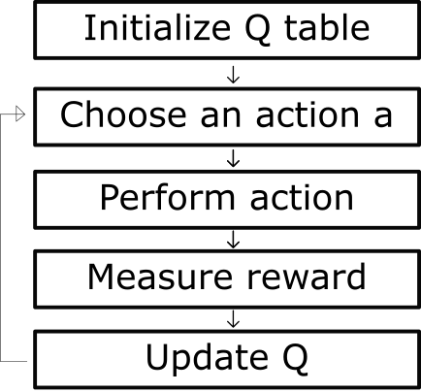
Background Q-Learning Algorithm
[10]

Slide 5
Background Q-Learning
γ- discount value- determines importance of future rewards
0 ≤ γ ≤ 1
α- learning rate- the rate of how fast q-values are updated
0 < α ≤ 1

Slide 6
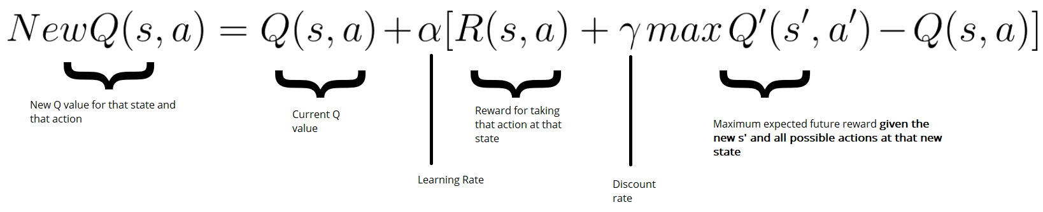
Background Q-Learning Bellman Equation
[10]

Slide 7
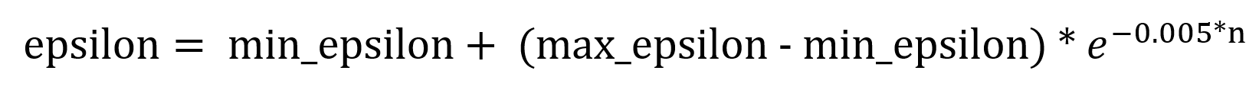
Background Decaying Epsilon-Greedy Algorithm
[4]
Generate random number from 0 to 1
If random number < epsilon
Choose random action
Else
Chose action with the largest reward

Slide 8

Background Minecraft & Malmo
3D sandbox game for the PC
Everything in the game is comprised of cubes
Movement- jump, crouch, forward, backward, left, right
AI experimental platform

Slide 9
Primary Objective
To examine and compare the effects of α and γ have on the time that it takes a program to lead a bot to the end of a maze using Q-Learning
Limitation: 1.5 person weeks

Slide 10
Solution Description
Implement Q-Learning in the Python environment
Run in Minecraft using the AI tool Project Malmo

Slide 11
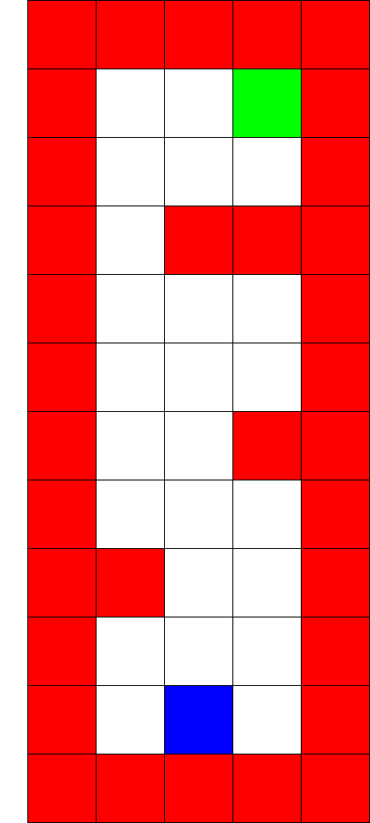

Solution Description

Slide 12
Hypothesis
Hypothesis: α has a greater effect on reducing the time it takes to solve a maze than γ
Null Hypothesis: Adjusting the values of α and γ have no effect on the time that it takes to complete a maze

Slide 13
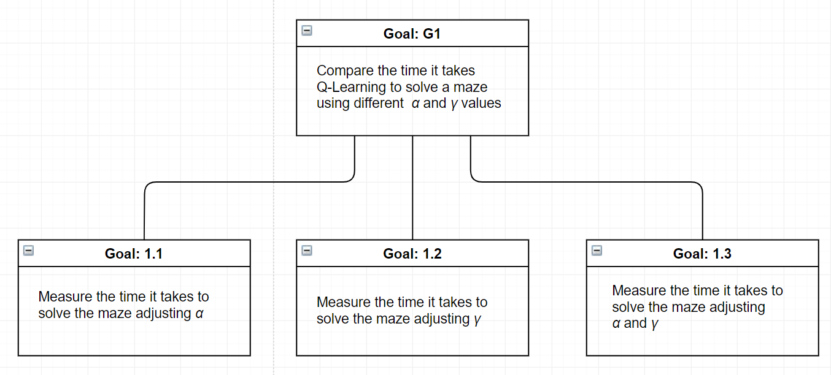
Goal Tree

Slide 14
Experiment Design
Create 30 different runs for each unique pair of α and γ values
Measure the time each run takes to solve maze

Slide 15
Experiment Design
Runtime | Low Gamma | Med Gamma | High Gamma
Low Alpha | x sec | x sec | x sec
Med Alpha | x sec | x sec | x sec
High Alpha | x sec | x sec | x sec

Slide 16
Results & Conclusions
 | α = 0.1 γ = 0.99 | α = 0.1 γ = 0.6 | α = 0.1 γ = 0.1
Avg Runs | 155 ± 7 | 186 ± 11 | 449 ± 42
Avg Time in Seconds | 564.90 ± 15.18 | 711.19 ± 27.51 | 1979.77 ± 132.62
95% Confidence Interval Runs | 2.49 | 3.94 | 15.1
95% Confidence Interval Time | 5.4335 | 9.8442 | 47.4582

Slide 17
Results & Conclusions
 | α = 0.4 γ = 0.99 | α = 0.4 γ = 0.6 | α = 0.4 γ = 0.1
Avg Runs | 110 ± 13 | 114 ± 13 | 139 ± 8
Avg Time in Seconds | 307.77 ± 33.33 | 339.14 ± 32.78 | 486.35 ± 20.65
95% Confidence Interval Runs | 4.74 | 4.73 | 2.89
95% Confidence Interval Time | 11.928 | 11.731 | 7.3907

Slide 18
Results & Conclusions
 | α = 0.99 γ = 0.1 | α = 0.99 γ = 0.99 | α = 0.99 γ = 0.6
Avg Runs | 101 ± 14 | 101 ± 14 | 111 ± 14
Avg Time in Seconds | 261.04 ± 34.22 | 261.15 ± 38.74 | 288.31 ± 33.89
95% Confidence Interval Runs | 4.83 | 5.04 | 4.95
95% Confidence Interval Time | 12.247 | 13.863 | 12.128

Slide 19
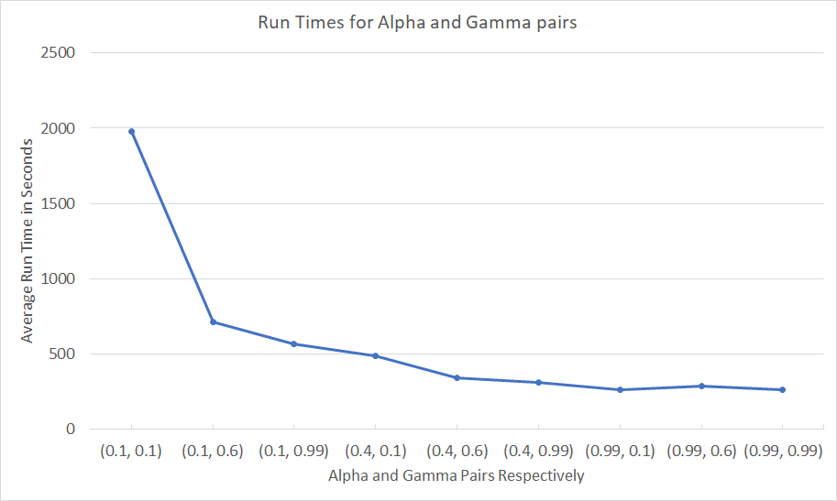
Results & Conclusions

Slide 20
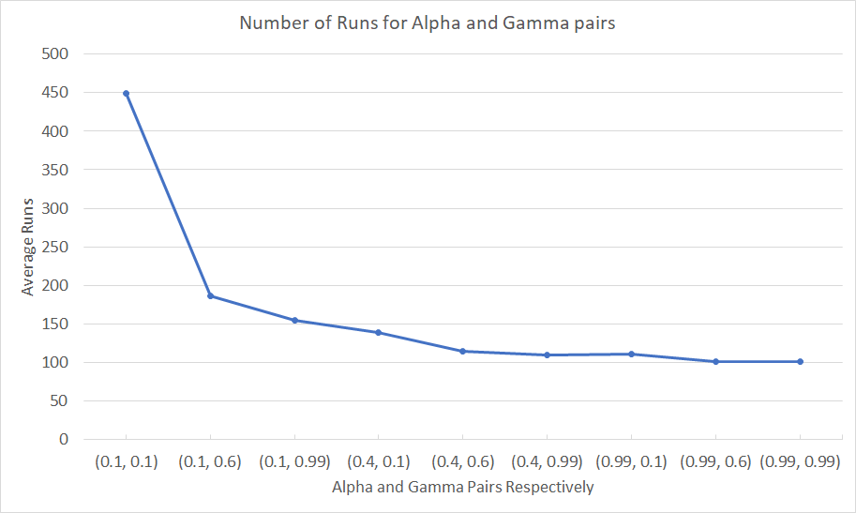
Results & Conclusions

Slide 21
Results & Conclusions
Average change in time with varying alpha and static gamma values:
433.3741 seconds
Average change in time with varying gamma and static alpha values:
269.2373 seconds

Slide 22
Results & Conclusions
Alpha does have a greater effect on run times than gamma
Reject the null hypothesis

Slide 23
Future Work
Experiment with Greedy Epsilon Policy
Experiment with static Epsilon
Experiment with a larger maze

Slide 24
Questions

Slide 25
Resources
Carvalho, Marco. “A Distributed Reinforcement Learning Approach to Mission Survivability in Tactical MANETs.” In Proceedings of the 5th Annual Workshop on Cyber Security and Information Intelligence Research: Cyber Security and Information Intelligence Challenges and Strategies, 21:1–21:4. CSIIRW ’09. New York, NY, USA: ACM, 2009. https://doi.org/10.1145/1558607.1558632.
“DFR1.Pdf.” Accessed April 16, 2019. http://ai.stanford.edu/~nir/Papers/DFR1.pdf.
Draper, David. “Bayesian Modeling, Inference and Prediction,” n.d., 305.
Implementations from the Free Course Deep Reinforcement Learning with Tensorflow: Simoninithomas/Deep_reinforcement_learning_Course. Jupyter Notebook, 2019. https://github.com/simoninithomas/Deep_reinforcement_learning_Course.
James D. McCaffrey. “The Epsilon-Greedy Algorithm,” November 30, 2017. https://jamesmccaffrey.wordpress.com/2017/11/30/the-epsilon-greedy-algorithm/.
Johnson, Matthew, Katja Hofmann, Tim Hutton, and David Bignell. “The Malmo Platform for Artificial Intelligence Experimentation,” n.d., 2.
Li, Mao, Tim Brys, and Daniel Kudenko. “Introspective Reinforcement Learning and Learning from Demonstration.” In Proceedings of the 17th International Conference on Autonomous Agents and MultiAgent Systems, 1992–1994. AAMAS ’18. Richland, SC: International Foundation for Autonomous Agents and Multiagent Systems, 2018. http://dl.acm.org/citation.cfm?id=3237383.3238048.

Slide 26
Resources
7. “Minecraft.” In Wikipedia, March 24, 2019. https://en.wikipedia.org/w/index.php?title=Minecraft&oldid=889310844.
8. “Reinforcement Learning - Algorithms.” Accessed April 1, 2019. https://www.cse.unsw.edu.au/~cs9417ml/RL1/algorithms.html.
9. Simonini, Thomas. “Diving Deeper into Reinforcement Learning with Q-Learning.” freeCodeCamp.org, April 10, 2018. https://medium.freecodecamp.org/diving-deeper-into-reinforcement-learning-with-q-learning-c18d0db58efe.
10. Udagawa, Hiroto, Tarun Narasimhan, and Shim-Young Lee. “Fighting Zombies in Minecraft With Deep Reinforcement Learning,” n.d., 6.
11. Wingate, David, Noah D Goodman, Daniel M Roy, Leslie P Kaelbling, and Joshua B Tenenbaum. “Bayesian Policy Search with Policy Priors,” n.d., 6.

